Slide 1

Analysis of Potential Expansion Activities

Slide 2
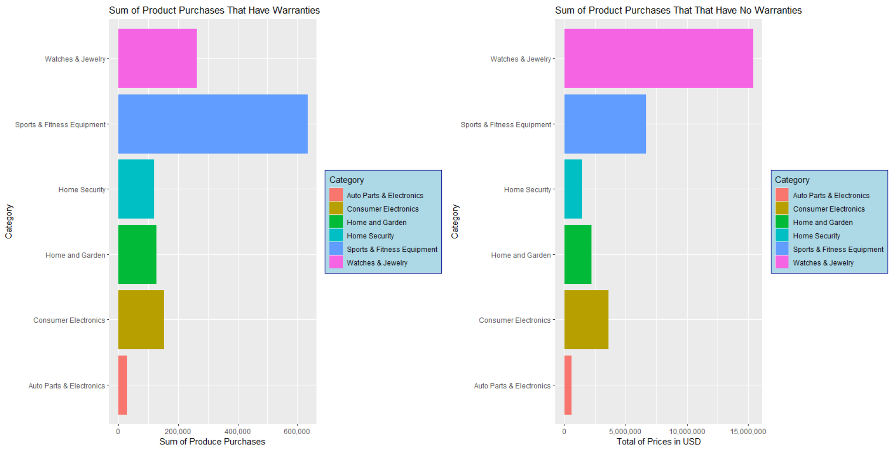
Market Analysis

Slide 3
Market Analysis
Warranties are being sold for more expensive Sports & Fitness Equipment products and for Watches & Jewelry.
The value covered by jewelry still leaves room for growth.
15 million in jewelry was ordered that was not covered.
Less than 400k was included in coverage by warranties.
The value covered by Sports & Fitness Equipment is stronger than jewelry.
6 million was ordered in Sports & Fitness Equipment not covered.
Over 600k in Sports & Fitness Equipment is covered.

Slide 4
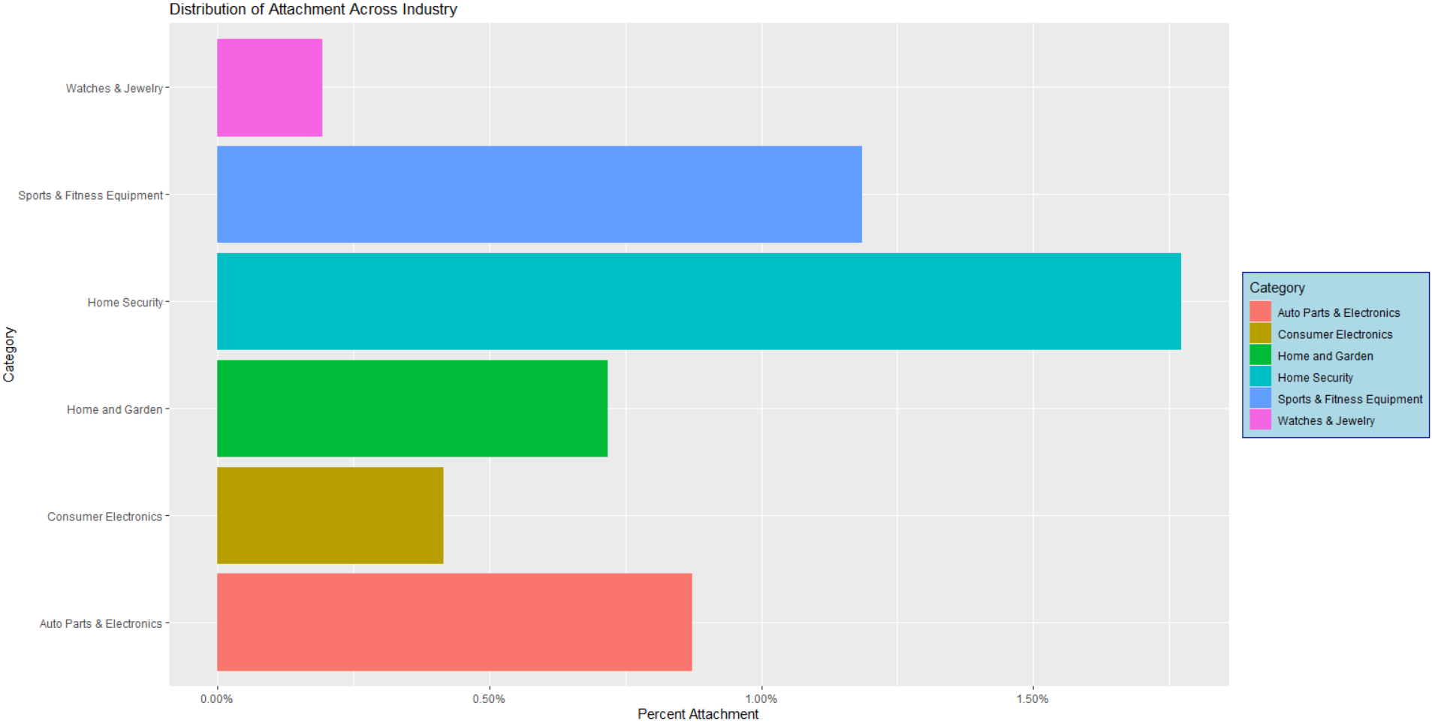

Slide 5
Market Analysis: Attachment
Home Security has highest attachment rate
Probably not surprising
If you are going to buy home security, then you probably have a low risk tolerance
Lack of Strong Growth
Since there is limited consumption of the base product, growth will be limited
If growth strategy is more conservative, then it may make sense.
Would require more partners in this area to make this option more attractive.
Sports Equipment has second highest attachment rate
Over 6 million dollars in product were ordered that were not covered by warranty.
Suggests strong opportunity for growth if attachment rate could increase

Slide 6
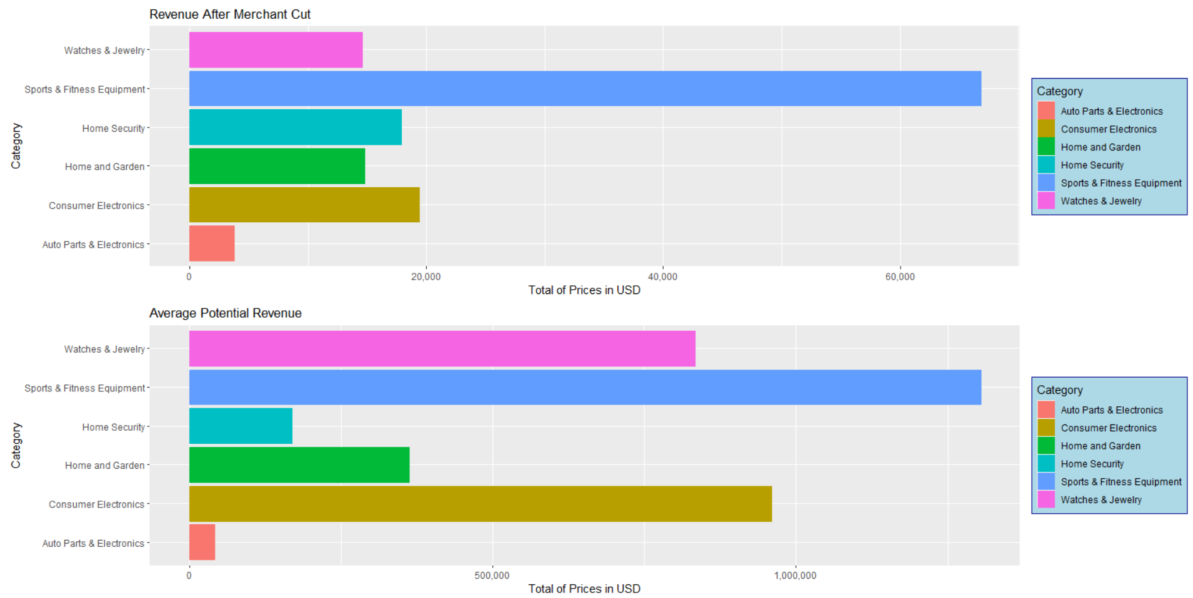

Slide 7
Revenue Analysis
Revenue is dependent on Sports and Fitness.
It may be a business risk to have so much revenue coming from one kind of merchant. It would be advisable to increase the diversity of revenue resources .
There is still significant opportunity not captured within Sports and Fitness.
Average Potential Revenue is based on the mean merchant cut and mean price of plan per category.
There is strong revenue coming from home security and consumer electronics.
Given the attachment rate for home security, it may make sense to focus business development to encourage stable growth.
Additionally, consumer electronics follows a similar trend and may benefit from similar support.

Slide 8
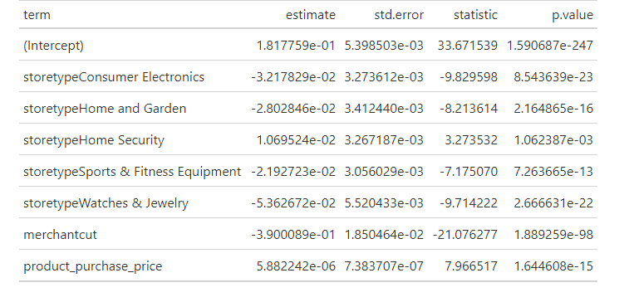
Statistical Analysis
Used Linear Model
Explanatory Variables
The kind of store
The purchase price of product
Cut given to merchant
Dependent Variable
Is if there is a warranty or not?
Coded as 1 if yes and 0 if not
There is a positive association between higher product prices and orders for home security merchants and Autoparts & Electronics . Autoparts & Electronics is part of the “intercept.”
There is the largest negative association with watches and jewelry.

Slide 9
Recommendations
Autoparts & Electronics and Home Security have the lowest barrier to increasing the attachment rate.
However, the amount of revenue gained from business development may not be large. It could make sense to promote balanced growth in business streams.
Sports & Fitness Equipment has the most opportunity for future revenue.
There are higher barriers in terms of changing the attachment rate.
Data suggests that a blended strategy may be useful.
A short-term strategy could focus on business development with the lower entry business sectors: Autoparts & Electronics and Home Security.
A long-term strategy could allocate resources to Sports & Fitness.
It is likely that diminishing returns will hit the lower barrier sectors eventually.
Once a threshold is hit, it may make sense to focus more on Sports & Fitness.

Slide 10
Next Steps
Additional points to evaluate
How long does it take to influence the adjustment rate?
Current Data Availability
There are only orders from March – May in the analysis. It is not enough to capture significant time-series effects.
Additional Data Required
Annual data would be useful to capture seasonality effects.
Impact of Analysis
Tailor strategy for targeting business sectors based on expected barriers to increasing attachment rate
Is the cut given to merchants an effective incentive?
Current Data Availability
Merchant Cut is provided per merchant per contract.
The negative association in statistical model suggests misalignment.
Additional Data Required
Greater variation in merchant cuts across products over an annual time-series.
Impact of Analysis
Validates that current incentives are sufficient and to optimize current incentive programs

